Slide 1
Old Ophir ranch special use permit
Washoe County Board of Adjustment| June 1, 2017

Slide 2
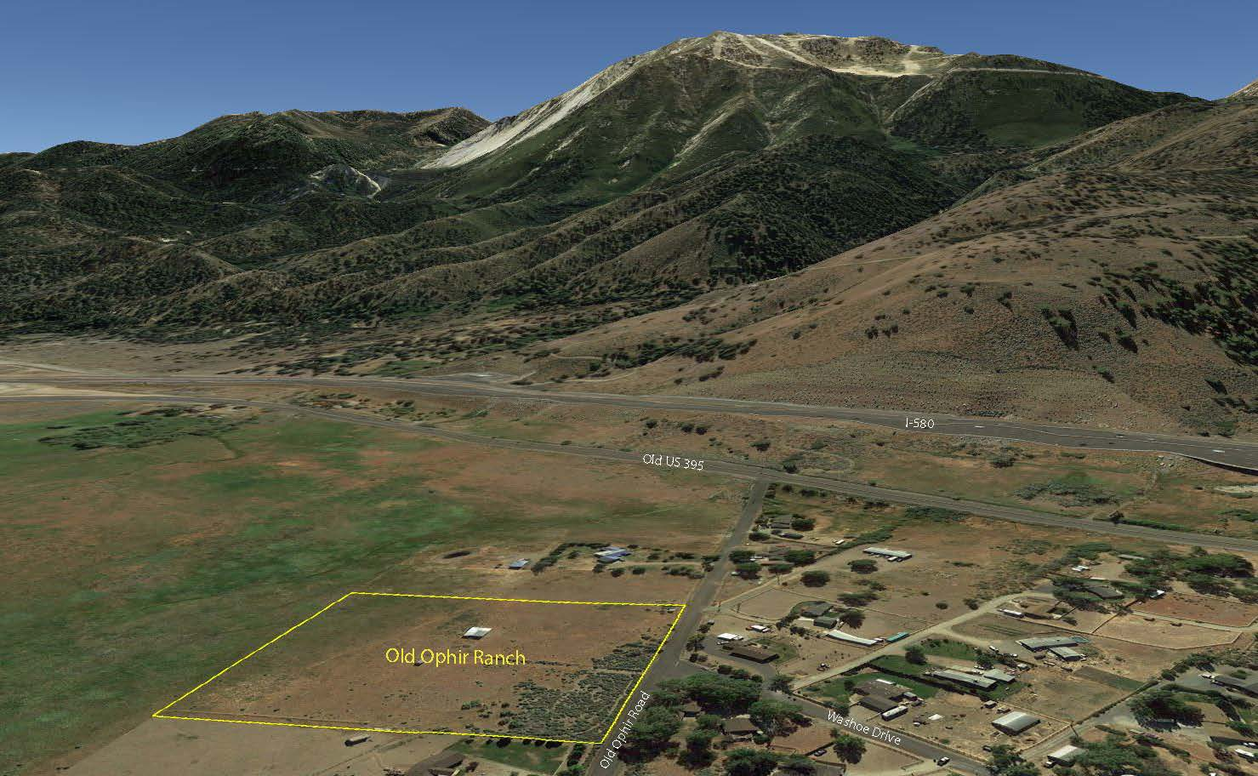
Project Background
Special Use Permit for Commercial Stables
Directors Modification for a Reduction in Standards
Presented at 2 CAB Meetings
Horse Retirement Facility
No Events or Training
Low Visitation
Applicant is Experienced

Slide 3
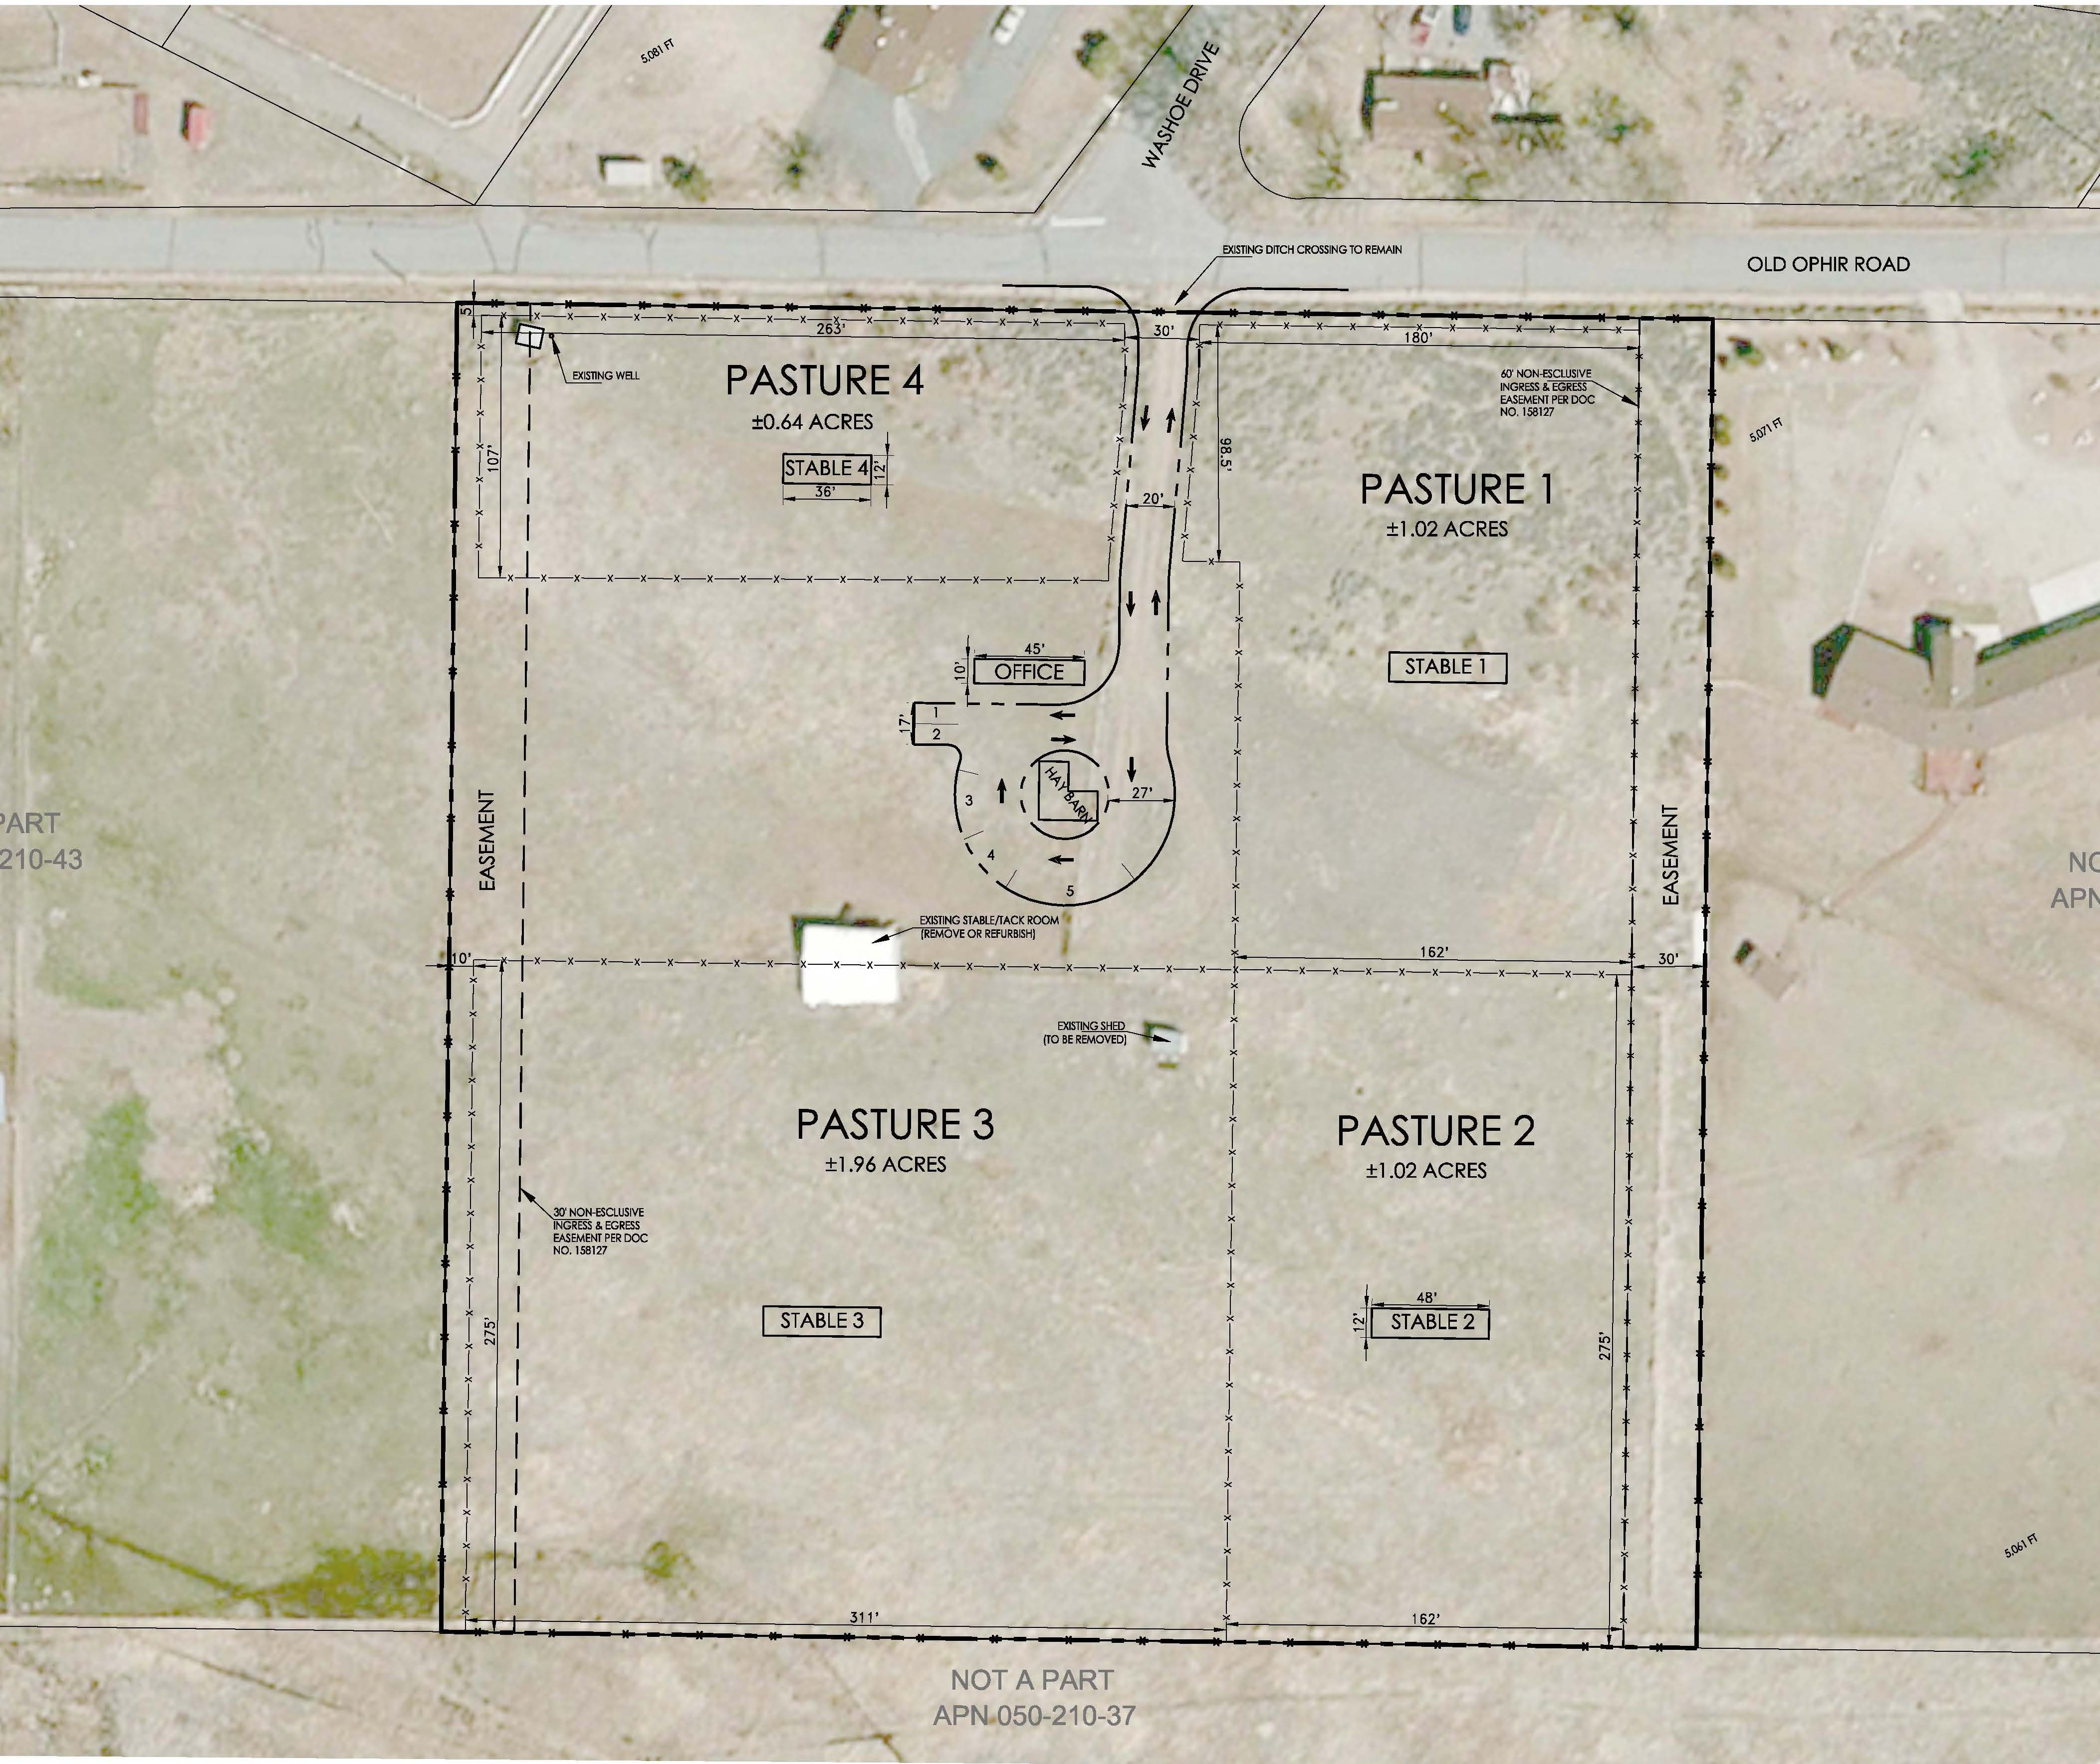
Phasing
Phase 1
Drive Aisle & Turn Around
Fencing of Pastures 1-4
Hay Barn & Stables
Temporary Office

Slide 4
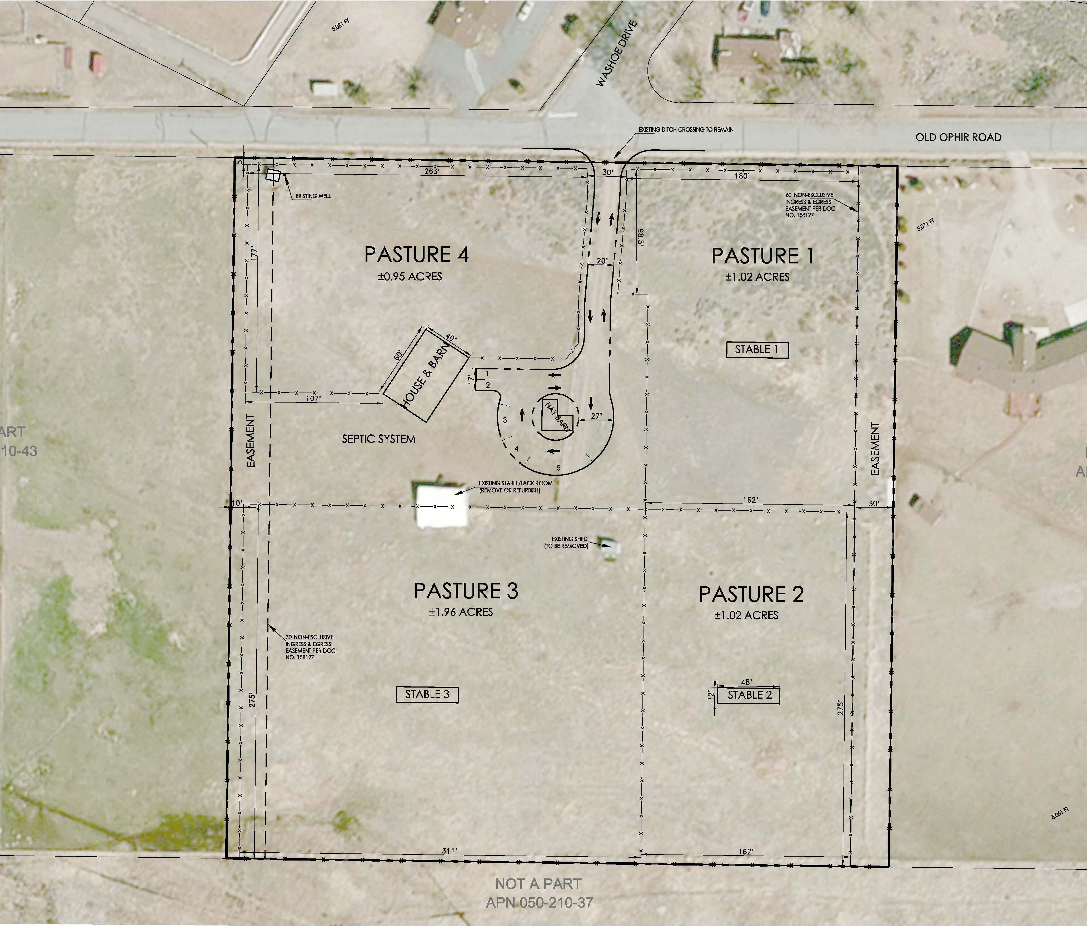
Phasing
Phase 1
Drive Aisle & Turn Around
Fencing of Pastures 1-4
Hay Barn & Stables
Temporary Office
Phase 2
House/Commercial Structure
Septic System

Slide 5
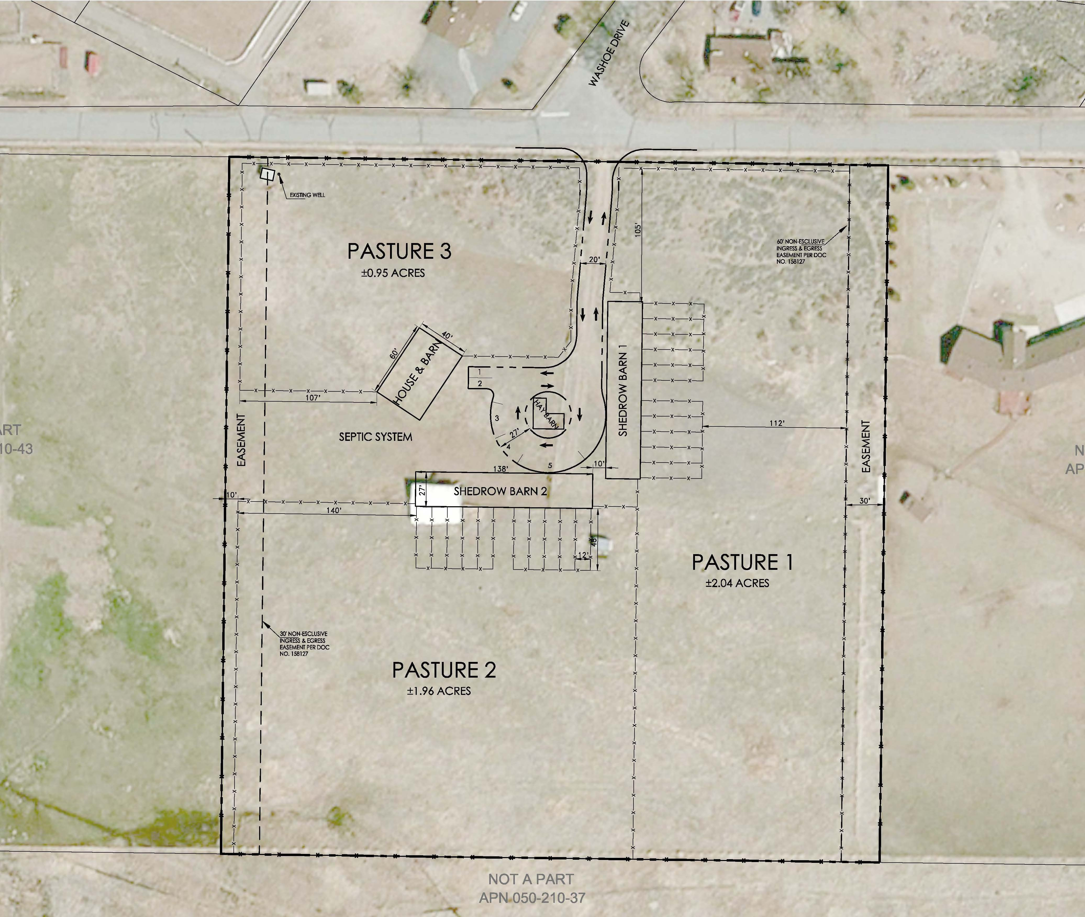
Phasing
Phase 1
Drive Aisle & Turn Around
Fencing of Pastures 1-4
Hay Barn & Stables
Temporary Office
Phase 2
House/Commercial Structure
Septic System
Phase 3
Shedrow Barns

Slide 6
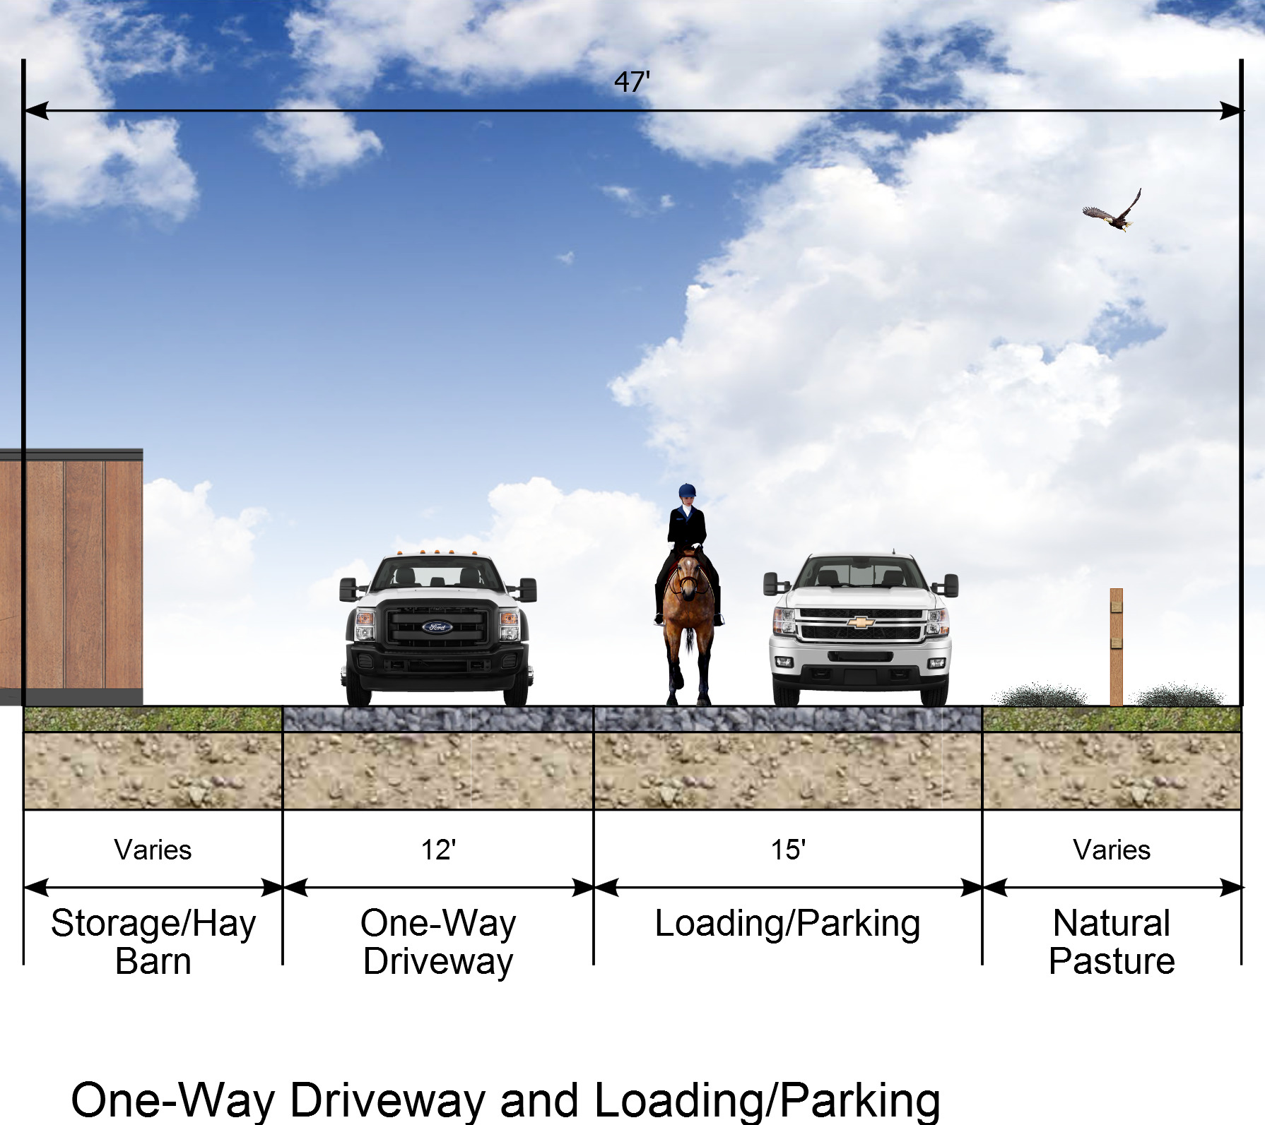
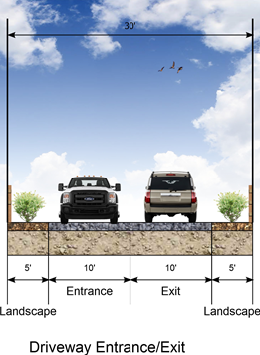
Key Concerns
Number of Horses
No Limit
Animal welfare permit
Manure Management
Submit Plan to Health Dist.
Equine Diseases
Vaccination Records Required
Preventative flu shots
Fire Evacuation
Plan Submitted to County

Slide 7
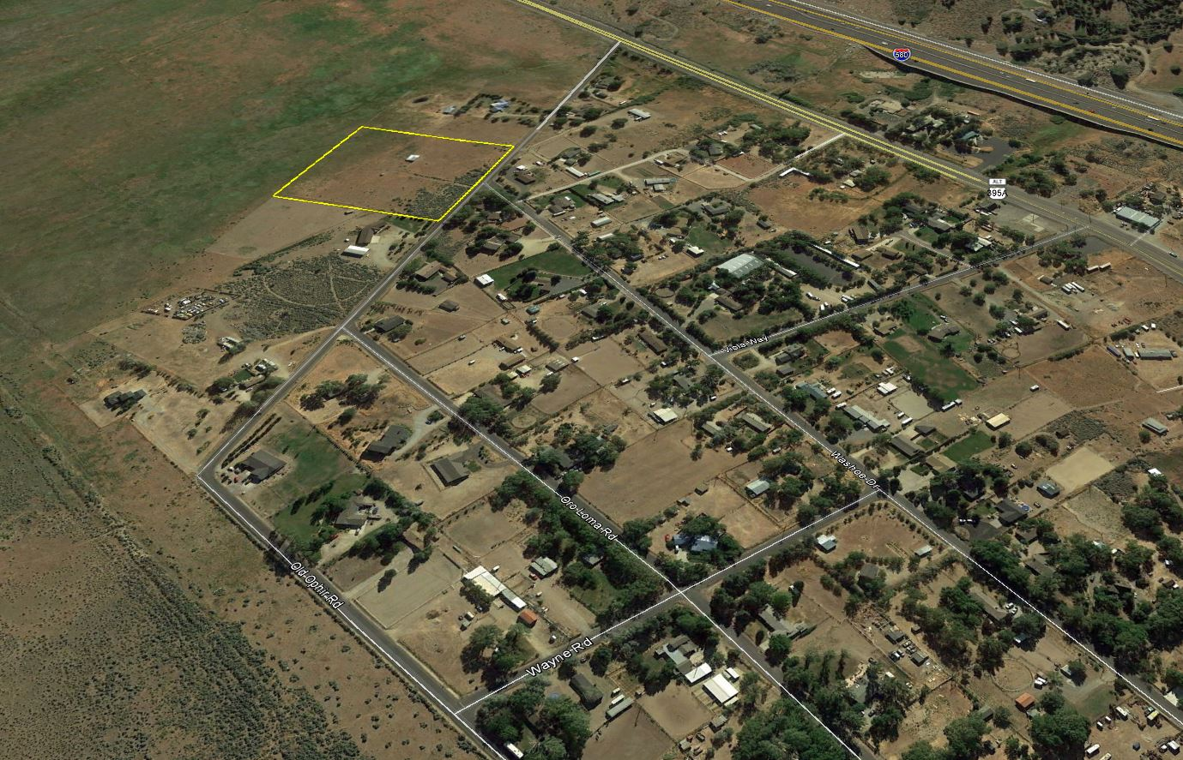
Key Concerns
Available Water
Water Rights Are Available
Loss of Pasture
Sustainable Pasture Management
Dust
Control Plan Required

Slide 8
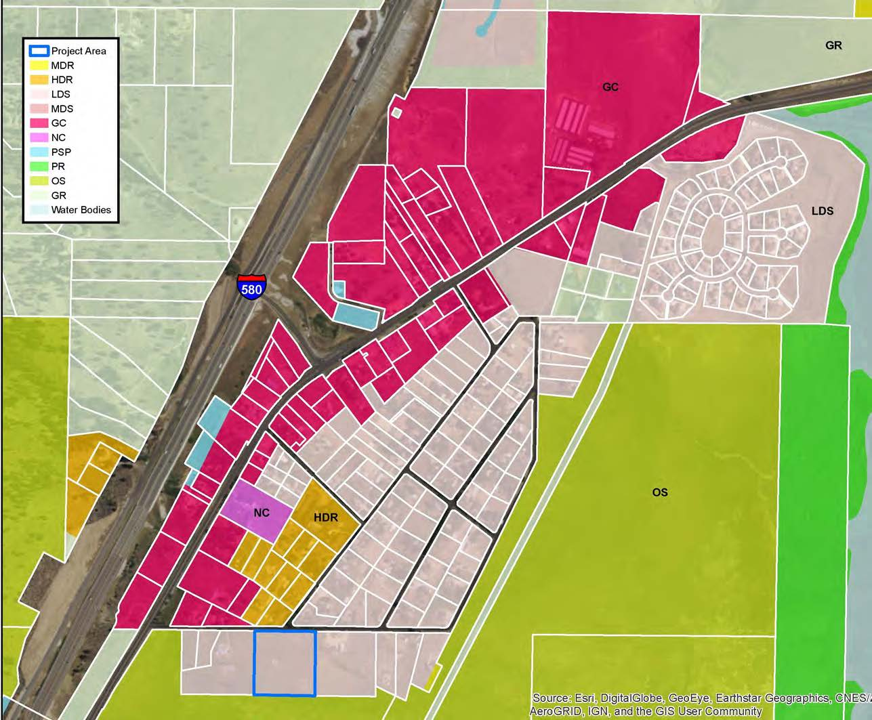
Closing
Residential Land Use Designations Allow Commercial Stables
Project is Located in Low Density Suburban
1 du/acre
County Concluded the SUP Met the Required Findings
Applicant Agrees with the Conditions of Approval in Staff Report

